Slide 1
What is XML?
XML stands for eXtensible Markup Language
XML is a markup language much like HTML
XML was designed to describe data
XML tags are not predefined in XML. You must define your own tags

Slide 2
The main difference between XML and HTML
XML was designed to carry data.
XML is not a replacement for HTML.
XML and HTML were designed with different goals:
  XML was designed to describe data and to focus on what data is.
  HTML was designed to display data and to focus on how data looks.
  HTML is about displaying information, XML is about describing information.

Slide 3
Advantages of XML
Human-readable
Machine-readable (easy to parse)
Standard format for data interchange
Possible to validate
Extensible
  can represent any data
  can add new tags for new data formats
Hierarchical structure (nesting)

Slide 4
Advantages of XML
XML is used to Exchange Data in B2B Projects
XML can be used to store the data
XML can makes our data more useful

Slide 5
XML Syntax
Tags properly nested
Tag names case-sensitive
All tags must be closed
Attributes enclosed in quotes
Document consists of a single (root) element

Slide 6
Element + Attribute
opening tag content closing tag
<name>car</name>
<name language=“English”>car</name>
attribute name = attribute value in quotes
Can have multiple attributes for one element
Notes:
If you have an empty tag with no content, you can just add a “/” before the “>” sign:
<name language=English”/>
Of course there are ways of indicating cardinality, possible content, and data types, etc.

Slide 7
XML Example
<?xml version="1.0"?>
<empdetails>
<emp>
<ename>Trendz</ename>
<empid>100</empid>
</emp>
<dept>
<deptno>10 </deptno>
<dname>Sales</dname>
</dept>
</empdetails>

Slide 8
XML document parts:
Prolog contains
  XML Declaration: version of XML
    <?xml version=“1.0”>
  Document Type Declaration (DTD)
    External and/or internal DTD
Document Element contains nested sub-elements and external entities

Slide 9
DTD
Document Type Definition
A grammar for XML documents
Defines
  which elements can contain which other elements
  which attributes are allowed/required/permitted on which elements

Slide 10
DTD Example
<!ELEMENT empdetails (emp+,dept+)>
<!ELEMENT emp (ename,empid) >
<!ELEMENT ename (#PCDATA) >
<!ELEMENT empid (#PCDATA) >
<!ELEMENT dept (deptno,dname) >
<!ELEMENT deptno (#PCDATA) >
<!ELEMENT dname (#PCDATA) >

Slide 11
Well-Formed vs. Valid
Well-Formed:
  Structure follows XML syntax rules
Valid:
  Structure conforms to a DTD

Slide 12
Internal DTD
<!DOCTYPE empdetails[
<!ELEMENT…….
]>
Defines the structure of the Document Element and its sub-elements
Internal DTD values may override settings in the external DTD

Slide 13
External DTD
<!DOCTYPE empdetails SYSTEM “xxx.dtd”>
External DTD reference includes:
  Document title
  Keywords: PUBLIC, SYSTEM,
  File name for the .dtd file where the definition is stored
Most large systems use external DTD’s

Slide 14
Attributes in DTD
<!ATTLIST TagName AttributeName AttributeType DefaultValue />
Example:
<!ELEMENT book (bname,price)>
<!ATTLIST book bid ID #REQUIRED >
Here
AttributeType can ID,ENUMARATION,IDREF,….
DefaultValue can #REQUIRED,#FIXED,#IMPLIED

Slide 15
XML Namespaces
A single document can use multiple DTDs
But! Two DTDs can use the same element name with different rules
Solution: Namespaces

Slide 16
Problems with XML DTDs
  It's not XML syntax
    You write your XML document using one syntax and the DTD using another syntax -> inconsistent, more work for the parsers.
  Limited set of primitive datatypes
    Desire a set of datatypes compatible with those found in databases
      One of the main weaknesses of DTD is its lack of support for data types beyond character strings (PCDATA).
  Limited support for applying constraints.
    Can support only constraints like “+” (1 or more occurences), “?” (0 or 1 occurences), “*” (0 or more occurences), etc. No facility for providing constraints like those found in databases (enumerations, ranges, string length, etc.)
Designed by Trendz R&D Team

Slide 17
XML Schema
XML Schemas are an improvement over DTDs:
  Enhanced datatypes.
    Wider range of primitive data types, supporting those found in databases (string, boolean, decimal, integer, date, etc.)
    Can create your own datatypes (complexType)
  Written in the same syntax as XML documents.
  Object-oriented
    Can derive new type definitions on the basis of old ones (refinement)
  Can have further constraints on the range of data values.
    Examples: maxlength, precision, enumeration, maxInclusive (upper bound), minInclusive (lower bound), encoding (applies only to binary)
Designed by Trendz R&D Team

Slide 18
XSL: XML Transformation

Slide 19
XSL
The eXtensible Style Language
Transforms XML into HTML
Actually, transforms XML into a tree, then turns that tree into another tree, then outputs that tree as XML

Slide 20
XSL Architecture
XSL
Stylesheet
XML
Source
XSL
Processor
HTML
Output

Slide 21
XSL Introduction
Data
HTML
XML
XML-
Parser
Document
Tree
Stylesheet
Processor
DTD
XSL
Structure
Transformation

Slide 22
XPath
The stuff inside the quotes in XSL patterns
  "/person/name/firstname"
A sensible way to locate content in an XML document
More straightforward than walking a DOM tree or waiting for a SAX callback

Slide 23
XPath Syntax
book/title
  title child of book child of current node
/book/title
  title child of book child of document root
@language
  language attribute of current node
chapter/@language
  language attribute of chapter child of current node

Slide 24
XPath Abbreviations
. | self::node()
.. | parent::node()
// | descendant-or-self::node()
@ | attribute::

Slide 25
XSLT

Slide 26
XSLT
XSLT stands for Extensible Stylesheet Language Transformations
XSLT is used to transform XML documents into other kinds of documents--usually, but not necessarily, XHTML
XSLT uses two input files:
  The XML document containing the actual data
  The XSL document containing both the “framework” in which to insert the data, and XSLT commands to do so

Slide 27
Very simple example
File data.xml:
  <?xml version="1.0"?>
  <?xml-stylesheet type="text/xsl" href="render.xsl"?>
  <message>Howdy!</message>
File render.xsl:
  <?xml version="1.0"?>
  <xsl:stylesheet version="1.0”
  xmlns:xsl="http://www.w3.org/1999/XSL/Transform">
  <xsl:template match="/">
  <html><body>
  <h1><xsl:value-of select="message"/></h1>
  </body></html>
  </xsl:template>
  </xsl:stylesheet>

Slide 28
The .xsl file
An XSLT document has the .xsl extension
The XSLT document begins with:
  <?xml version="1.0"?>
  <xsl:stylesheet version="1.0"
  xmlns:xsl="http://www.w3.org/1999/
  XSL/Transform">
Contains one or more templates, such as:
  <xsl:template match="/"> ... </xsl:template>
And ends with:
  </xsl:stylesheet>

Slide 29
Finding the message text
The template <xsl:template match="/"> says to select the entire file
  You can think of this as selecting the root node of the XML tree
Inside this template,
  <xsl:value-of select="message"/> selects the message child
  Alternative Xpath expressions that would also work:
    ./message
    /message/text() (text() is an XPath function)
    ./message/text()

Slide 30
How XSLT works
The XML text document is read in and stored as a tree of nodes
The <xsl:template match="/"> template is used to select the entire tree
The rules within the template are applied to the matching nodes, thus changing the structure of the XML tree
  If there are other templates, they must be called explicitly from the main template
Unmatched parts of the XML tree are not changed
After the template is applied, the tree is written out again as a text document

Slide 31
Links: XML
XML Spec
  http://www.w3.org/TR/REC-xml
XML FAQ
  http://www.ucc.ie/xml/
XML.com
  http://www.xml.com/
Servlet FAQ in XSL
  http://www.purpletech.com/servlet-faq/

Slide 32
JAXP – Java API for XML Processing
To use XML data in our applications -> we must parse XML documents
Parsing is dissecting a body of text into its individual components
<para>This is <emphasis>very important</emphasis> info!</para>
JAXP uses parser standards for:
- Simple API for XML Parsing (SAX)
- Document Object Model (DOM)
- XML Stylesheet Language Transformations (XSLT)
JAXP allows you to use any XML-compliant parser (such as Xerces)
from within your application. It uses a ‘plugability layer’ which allows
you to plug in an implementation of the SAX or DOM APIs, or an XSL
processor without changing your code -> Factory settings
JAXP Specifications -> Standard
JAXP Implementations -> Number available, differing implementation
bugs and specification deviations

Slide 33
JAXP – Parsing
JAXP API included in J2SDK, Standard Edition
The main JAXP APIs are defined in the javax.xml.parsers package
javax.xml.parsers contains two vendor-independent factory classes:
- SAXParserFactory – gives you a SAXParser (used for SAX)
- DocumentBuilderFactory – gives you a DocumentBuilder, which in turn
creates a DOM-compliant Document Object (used for DOM)
SAX
DOM
Serial, event driven mechanism
Fast, efficient
Requires little memory
Handles data when encountered
Typically more suitable for server-side
reading of data
Provides a tree structure of objects
Powerful capabilities/Complex coding
Higher memory/CPU requirements
Entire XML structure read in first
Suitable for interactive modification of
XML

Slide 34
Simple API for XML (SAX)
Standard Interface for event-based XML Parsing
Identifies the elements as the parser reads them
Informs the application of events, such as the start and end of elements
SAX works very well when you simply want to read data and use it

Slide 35
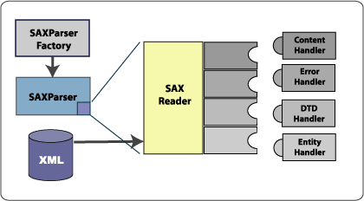
Simple API for XML (SAX)
Instance of SAXParserFactory -> Instance of SAXParser
SAXParser – in general you pass an XML data source and
a DefaultHandler object to the parser
SAXParser wraps a SAXReader -> performs communication
but is transparent to us
When SAXParser parse() method called, the SAXReader
calls one several methods defined by four interfaces

Slide 36
Simple API for XML (SAX)
ContentHandler - Methods like startDocument, endDocument, startElement and
endElement (among others) are invoked when an XML tag is recognised.
ErrorHandler - This interface can be used to implement your own error handling
DTDHandler - Defines methods which will will not use
EntityResolver - Used when the parser must identify data identified by a URL.
A typical application implements most of the ContentHandler methods, at a
minimum. For a more robust implementation the ErrorHandler should also be
Implemented – we won’t however!

Slide 37
Simple API for XML (SAX)
Steps:
1) import the required classes
2) extend the DefaultHandler class and define MyParser to be
be the handler (don’t get too concerned about this)
public class MyParser extends DefaultHandler
…
DefaultHandler handler = new MyParser();
3) create a SAXParserFactory instance
SAXParserFactory factory = SAXParserFactory.newInstance();
4) get a SAXParser from the factory
SAXParser saxParser = factory.newSaxParser();
5) give the parser an instance of this class to handle parsing
events, and provide the input file
saxParser.parse(new File(args[0]), handler);

Slide 38
Simple API for XML (SAX)
6) The ContentHandler interface requires a number of methods
that the SAX parser invokes in response to parsing events
public void startDocument() throws SAXException
public void endDocument() throws SAXException
public void startElement(….) throws SAXException
public void endElement(….) throws SAXException
public void characters(….) throws SAXException
7) Attributes are handled within the startElement() method
8) characters() method handles the characters that the parser
delivers to our application -> we accumulate parsed
characters into a text buffer -> buffer contains values
found between our elements

Slide 39
personnel.xml
<?xml version='1.0'?>
<personnel>
<person>
<firstname>David</firstname>
<lastname>Molloy</lastname>
</person>
<person>
<firstname>John</firstname>
<lastname>Smith</lastname>
</person>
<person>
<firstname>Jane</firstname>
<lastname>Grogan</lastname>
</person>
</personnel>

Slide 40
Document Object Model (DOM)
SAX is public-domain software, developed through collaboration
DOM = World Wide Web Consortium (W3C) standard
DOM not specifically designed for Java -> designed to represent
XML documents across all programming languages and tools
such as C++ and JavaScript
DOM models an XML document -> complete model representing
every aspect of an XML object
With DOM programmers can build documents, navigate their
structure, add, modify and delete elements and content
DOM is a garden-variety tree structure made up of nodes
Two most common: element nodes & text nodes

Slide 41
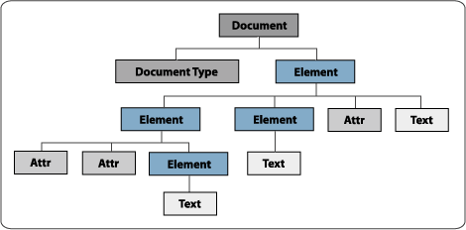
Document Object Model (DOM)
While SAX is event-driven, reporting events during parsing,
DOM supplies a complete-in-memory representation of the doc
Document is supplied to you in a tree structure, complete with
individual nodes representing elements, text, attributes etc.

Slide 42
eXtensible Stylesheet Language (XSL)
XSL is the language that describes how XML documents are displayed
XSL developed by the W3C Working Group
Consists of three parts
- XSLT (XSL Transformations)
- XSL Formatting Objects (XSL-FO)
- XPath
XSLT – is the language that specifies the conversion of a document from one
format to another, where the XSL stylesheet defines the means -> typically
used for for textual transformations, such as HTML or WML from XML
XSL-FO – formatting objects used when converting XML into binary formats
such as PDF files, or Word Documents. This part is not covered by JAXP or here
XPath – allows you to specify the part of the structure you are talking about
It allows you to distinguish between <name><title> and <qualification><title>
-> We can describe different transformations for different <title> elements

Slide 43
xslexample1.xml
<?xml version='1.0'?>
<?xml:stylesheet type='text/xsl' href='xslexample1.xsl'?>
<personnel>
<person>
<firstname>David</firstname>
<lastname>Molloy</lastname>
</person>
<person>
<firstname>John Peter</firstname> <lastname>Smith</lastname>
</person>
<person>
<firstname>Jane</firstname>
<lastname>Grogan</lastname>
</person>
</personnel>

Slide 44
xslexample1.xsl
<?xml version='1.0'?>
<xsl:stylesheet xmlns:xsl="http://www.w3.org/1999/XSL/Transform" version="1.0">
stylesheet is the top level element -> root of the XSL stylesheet tree
<xsl:template match="/"> associates the template with the root of the doc
<HTML>
<BODY bgcolor="wheat">
<xsl:for-each select="personnel/person"> works like a ‘for’ loop
selects the value of the <person> tag within the <personnel> root element
<BR/><H2>Employee</H2> <B>Firstname: </B>
<xsl:value-of select="firstname" /><BR/>
<B>Lastname: </B><xsl:value-of select="lastname" />
<BR/><BR/>
</xsl:for-each>
</BODY> </HTML>
</xsl:template>
</xsl:stylesheet>

Slide 45
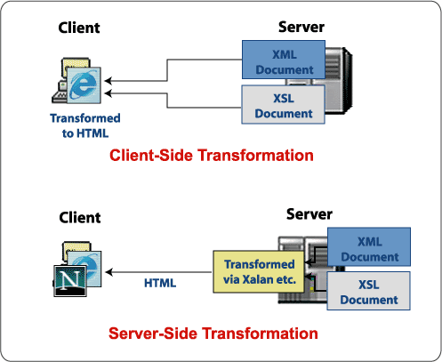
Client-Side/Server-Side Transformations

Slide 46
Client-Side/Server-Side
Internet Explorer 5.0+ goes a long way towards implementing client
side transformations of XML
Non standards compliant in many ways with some omissions/changes
Perform a client transformation example
Many advantages in performing a manual transformation on the server
- works across multiple browsers (HTML)
- lightweight clients
- transformations are performed in advance – quicker
java org.apache.xalan.xslt.Process –IN xslexample1.xml –XSL xslexample1.xsl
-OUT xslexample1.html
Work through second example in the notes xslcustomers.xml/.xsl

Slide 47
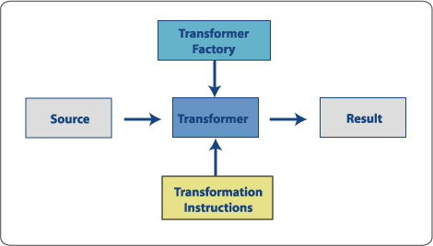
XSLT and JAXP
Often need to perform transformation real-time with dynamic data
Eg. XML to browser-specific HTML
XML to Wireless Markup Language (WML) for mobile phones
Personalized webpages/documentation
JAXP contains four packages responsible for handling XSLT
- javax.xml.transform
- javax.xml.transform.dom
- javax.xml.transform.sax
- javax.xml.transform.stream

Slide 48
XSLT and JAXP
Steps:
1) Import javax.xml.transform package classes and other classes
such as DOM packages if you use DOM
2) Instantiate a TransformerFactory object
TransformerFactory tFactory = TransformerFactory.newInstance()
3) Create a Transformer, in which we can define a set of transformation
instructions. In our example, we supply an XSL StreamSource
4) Perform the transformation on the input (which can be created
from a SAX reader, a DOM or an input stream) – in our example, we
provide a DOMSource. The transform method takes a second
argument, which in our example is a File (via a FileWriter)
5) Handle the possible exceptions
Work through the example in the notes

